Slide 1
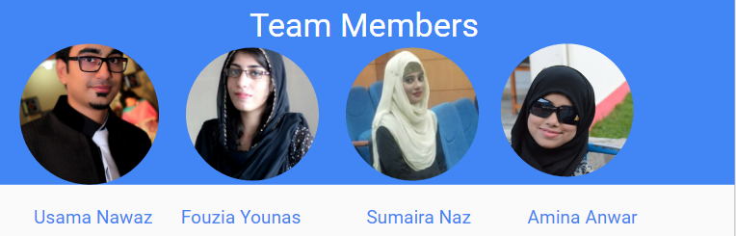
Reducing Gap between blood donors and recepients

Slide 2
Table of contents
Additional Interviews + Results
Revised 3 POV’s + 3 HMW’s
Experience Prototypes + Evaluation
Appendices (all POV’s + HMW’s)

Slide 3
Additional Interviews

Slide 4
Interviewee 1
Name: Dr. Ishfaq
Reason for Interview:
Blood Bank In charge at Jinnah Hospital Lahore.
Place of Interview: Jinnah Hospital, Lahore
Method of Recruitment: Contacted in person

Slide 5
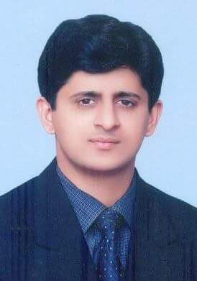
Interviewee 2
Name: Babar Aasi
Reason for Interview: head of Blood Bank society of GCU, Lahore
Place of Interview: GCU, Lahore
Method of Recruitment: Contacted in person

Slide 6
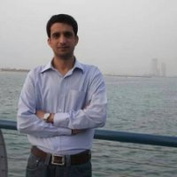
Interviewee 3
Name: Imran Durani
Reason for Interview: Active donor as well as receiver
Place of Interview: Gohar Centre, Lahore
Method of Recruitment: Met in person

Slide 7
POV’s &
HMW’s

Slide 8
POV # 1
We met: Dr. Muhammad Ishfaq , Blood Bank In charge at Jinnah Hospital Lahore
We were amazed: to realize that there is still manual process of updating blood records.
It would be game changing to: create such a database which can link between all hospitals to check blood availability.

Slide 9
POV # 2
We met: Babar Aasi. He is head of Blood Bank society of GCU
We were amazed: There are more number of registered donors but less are willing to donate
It would be game changing to: create such a platform where available donors can easily be accessed.

Slide 10
POV # 3
We met: Imran Durani, a businessman who is an active donor as well
We were amazed: Due to unavalaibilty of blood his grandmother died
It would be game changing to: minimize the gap between blood donors and receivers and create a platform where they can get blood on time.

Slide 11
hmw # 1
It would be game changing to: create such a database which can maintain the records of blood entries.
HMW: help him to reduce manual paperwork?

Slide 12
hmw # 2
It would be game changing to: create such a platform where available donors can easily be accessed.
HMW: give guidance to blood societies to connect on a single platform and how societies can aware students about blood donation?

Slide 13
hmw # 3
It would be game changing to: minimize the gap between blood donors and receivers and create a platform where they can get blood on time.
HMW:reduce the gap between donor and recipient?

Slide 14
prototypes

Slide 15
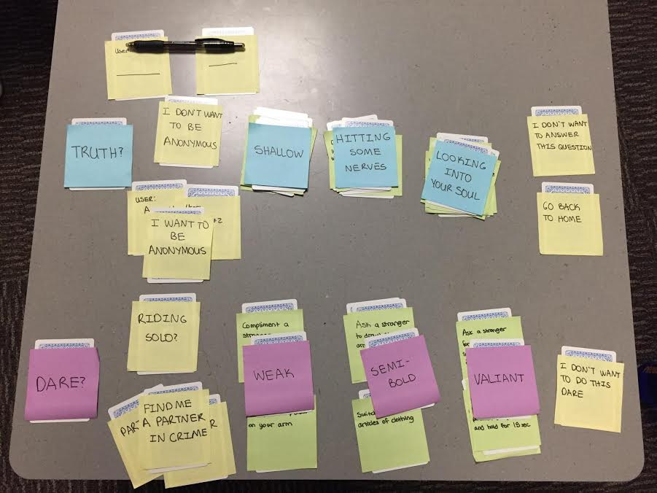
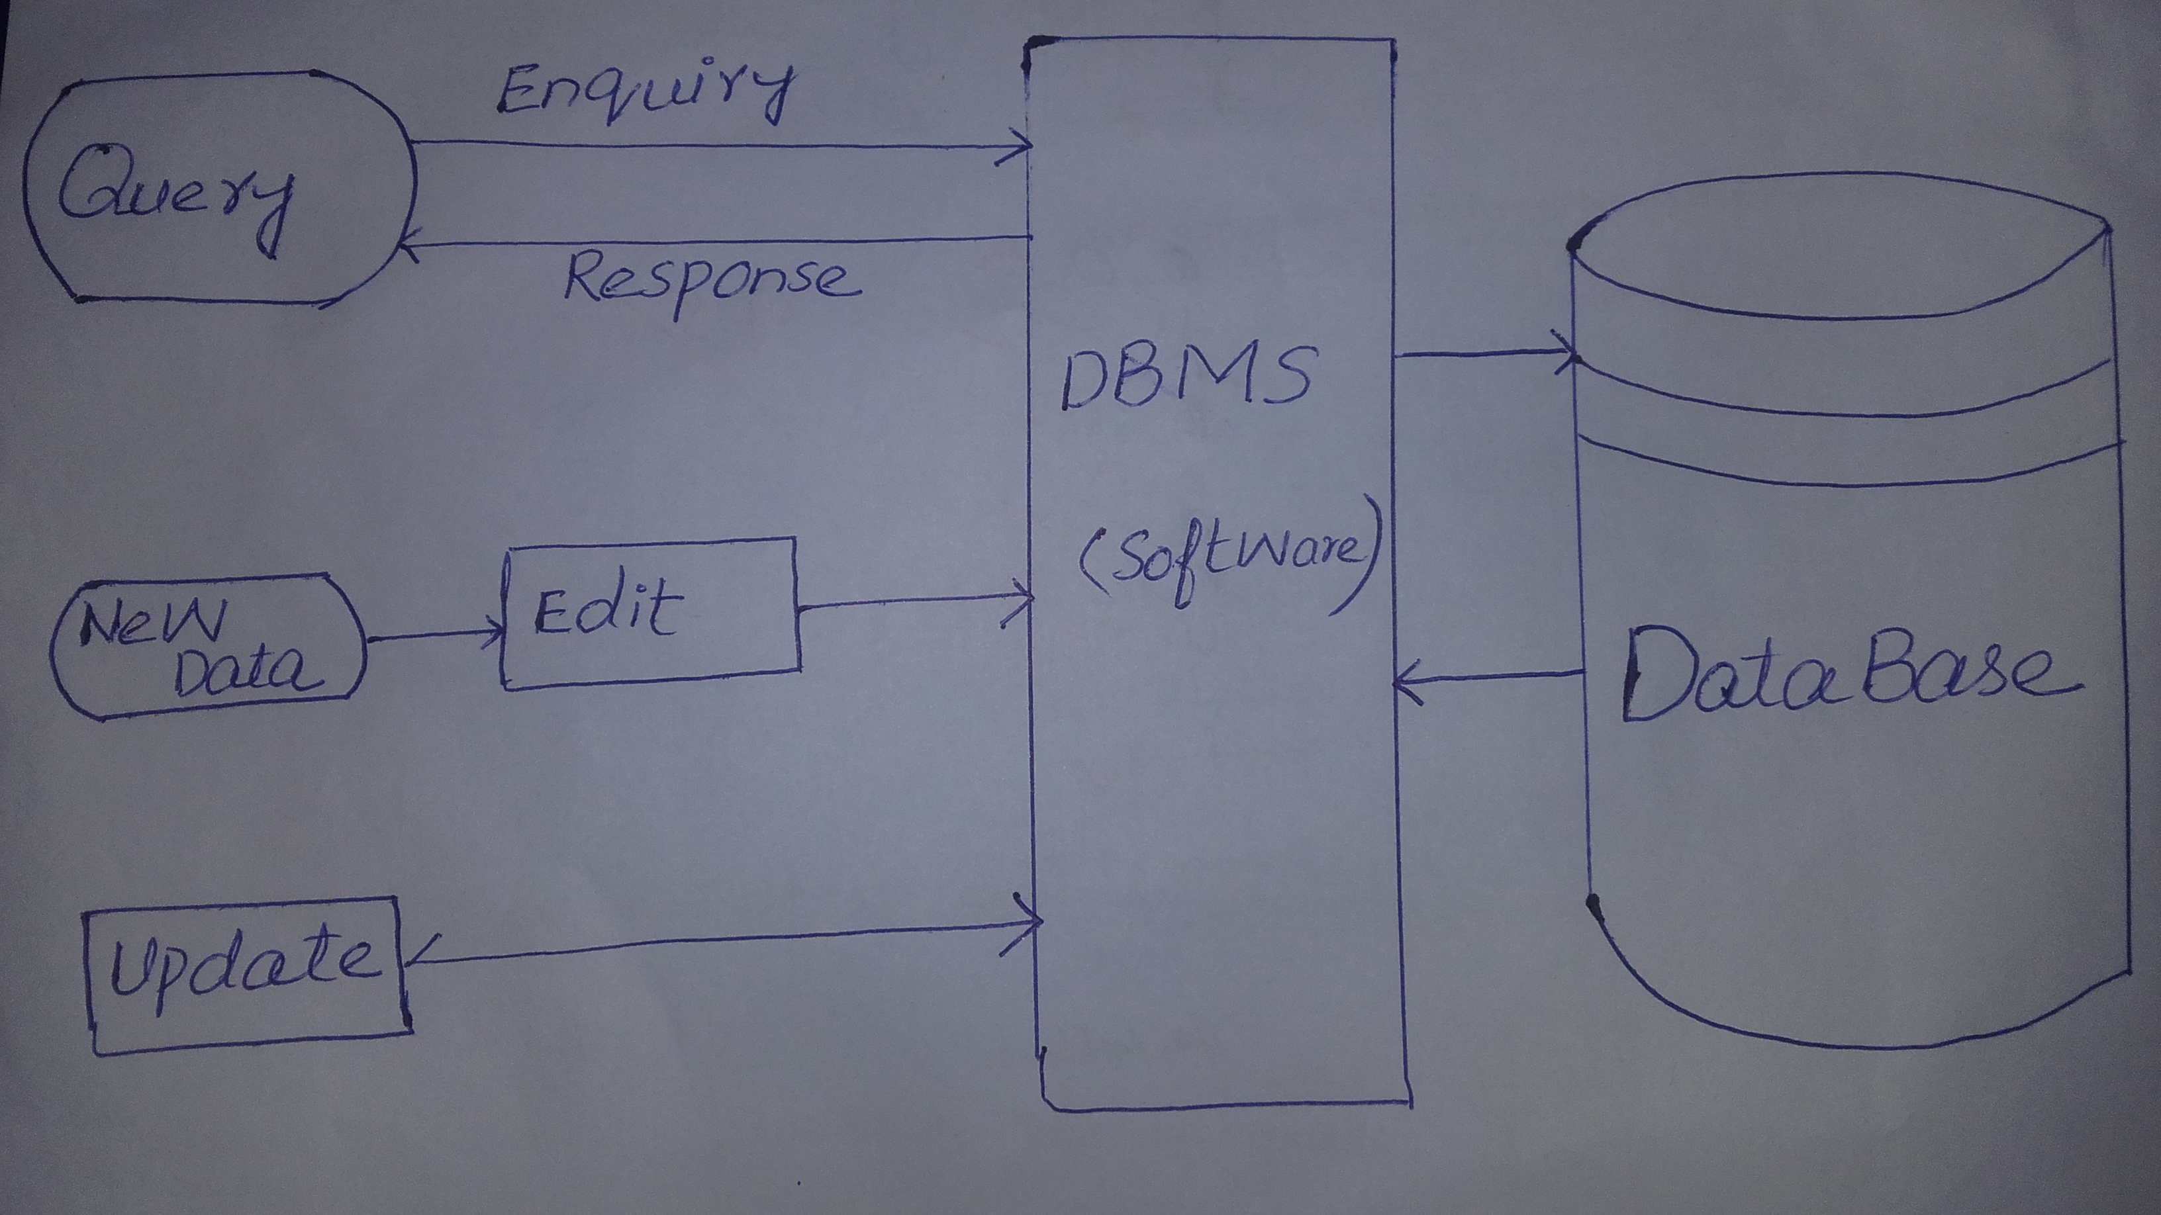
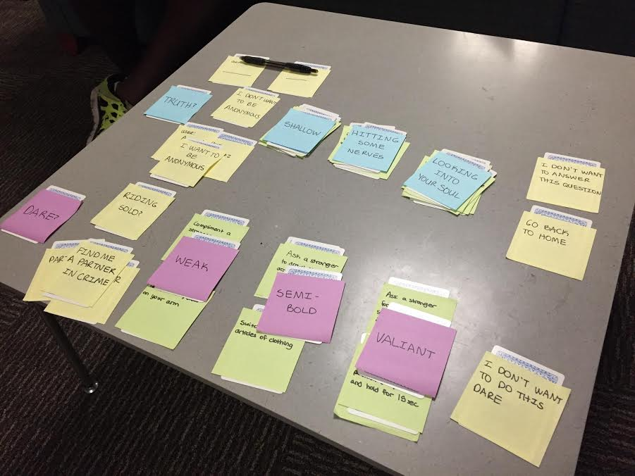
Prototype # 1: Automatic updating of blood entries
This prototype was created by taking a paper and drawing a single repository for maintaining their blood records. We put different sections where they can enter, update and query their records. It was centralized.

Slide 16
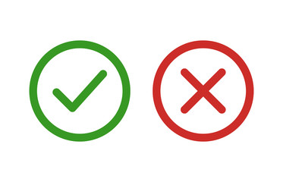
Assumptions
Assumption 1: They are eager to use technology for keeping records
Assumption 2: They have a knowledge of how to use the system
Assumption 3:Hospitals have proper resources e.g computers and internet

Slide 17
People may be more open to interacting with such systems
What Worked
It helps to shift from paper work to automatic system.
Users were happy for introducing this system
What Didn’t Worked
They don’t know about using the database software
Didn’t entirely know where to enter and update etc.
learnings
They need proper training if we implement this solution.
There is a dire need of implementing this system in blood banks

Slide 18
Testing Method
User was asked about their opinion if they can use
This System.
Debriefed after the experience

Slide 19
Prototype # 2: Spin the bottle
You spin the bottle and ‘match’ with an experienced traveler. The user then meets up with whoever they matched with and just talk about their experiences!

Slide 20
Testing Method
User spins a bottle and gets matched with a traveler
The two meet up and talk together

Slide 21
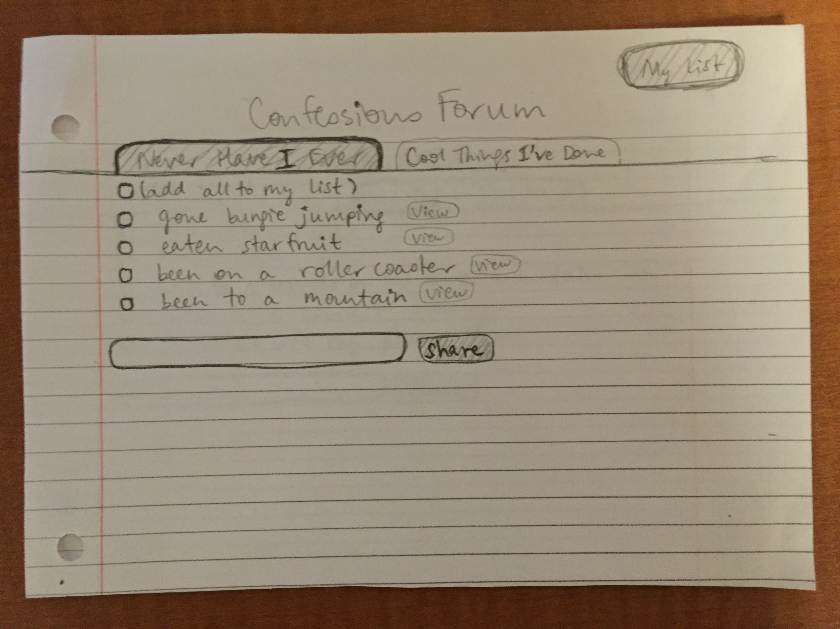
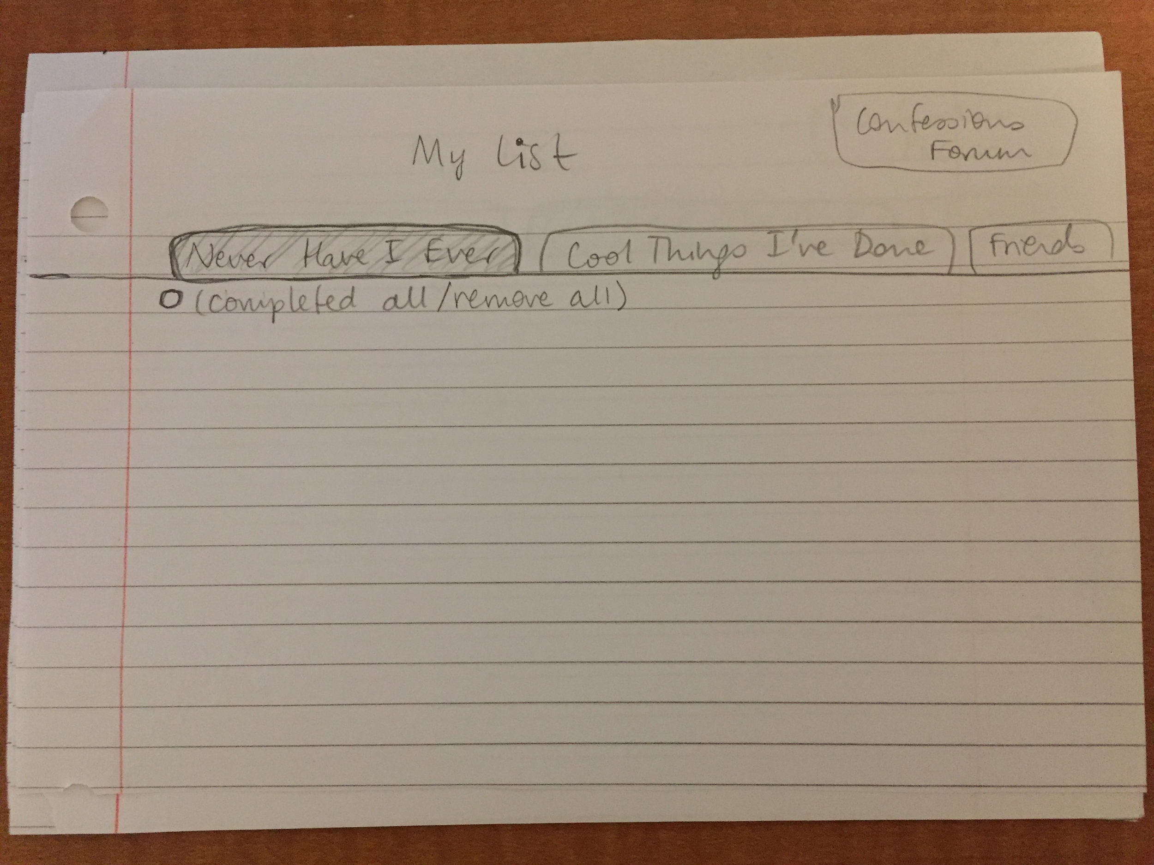
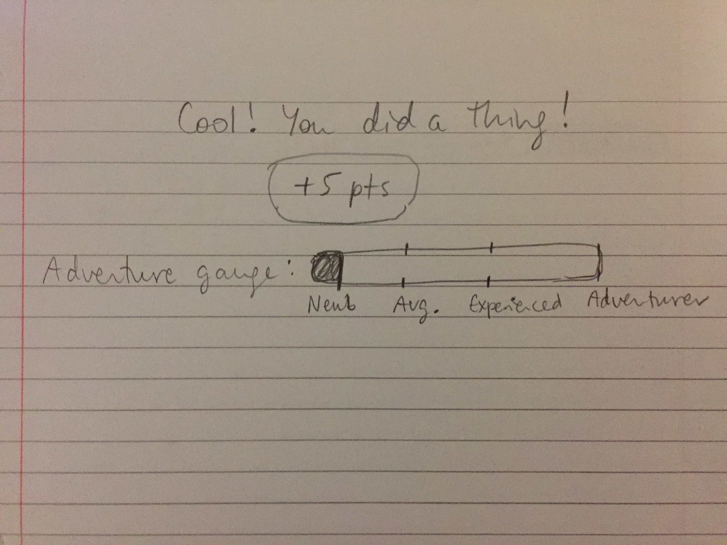
Prototype # 3: Confession Forum
A forum where travelers post things they’ve never done before and exciting experiences they’d like to share. You can make your own posts, add experiences/activities to your own personal list, and befriend others. As you empty your bucket list, you rise up the ranks to become an Adventurer.

Slide 22
Testing Method
Let the user explore by themselves, unaided
Provide some flow for the screen prototypes
Debrief after the experience

Slide 23
appendices

